Slide 1
DATA
ANALYTICS PORTFOLIO
Name of Project:
Presented By:
Data Analytics Portfolio
Hena Delic

Slide 2

Hello, I'm Hena
Delic!
I am a second year Masters in Data Science student at Boston University. I spent the summer of 2026 as a Data Analytics and Marketing intern at Starting Point NEO, a Child Care Resource and Referral Agency in Cleveland, OH. I was placed here as part of the Cleveland Foundation’s summer internship program. I learned a lot during my time at Starting Point and wanted to share the projects I worked on.
Name of Project:
Presented By:
Data Analytics Portfolio
Hena Delic

Slide 3

Summer Project
My main internship project this summer involved extracting, transforming and loading data from datasets across several programmatic areas at Starting Point. I then analyzed this data for major patterns in Microsoft Excel and used data visualization tools like PowerBI to convey my findings.
Goals & targets
Analytics & Reports
Adaptation & Evolution
My goal was to show that the work being done at Starting Point to support families and child care centers to offer the best care to young children is not only working but also driving change in the community.
My analytics will be used in this year’s annual report. Additionally, I collaborated with the marketing team to film a video series showcasing my work which is featured across their social media.
As the first person to analyze some of these datasets, my work will serve as a foundation for future analytics at the organization.

Slide 4
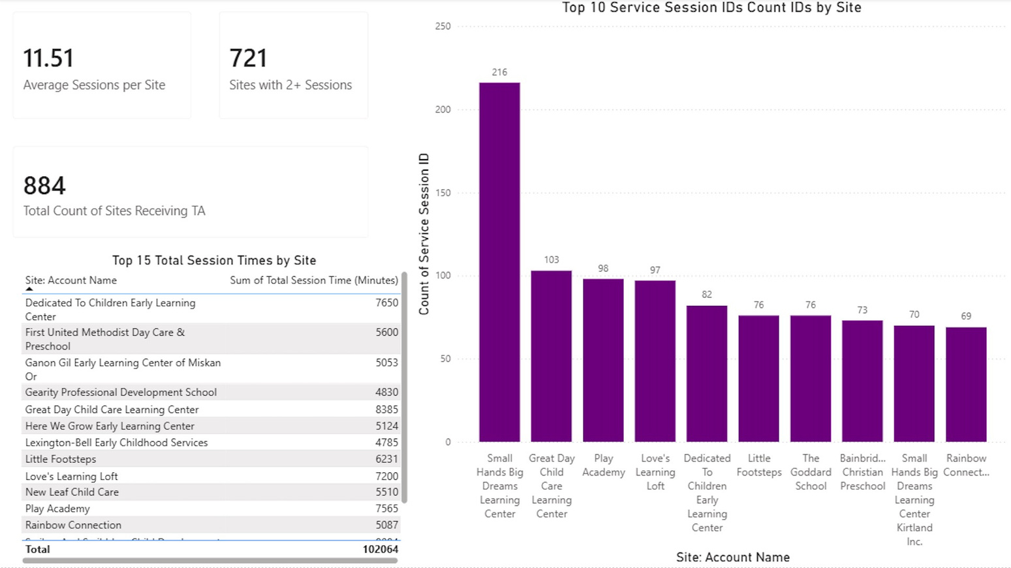
Part I: Technical Assistance
My goal was to compare how different child care centers performed before and after receiving Technical Assistance. Step Up to Quality is a three-star rating system used by the state of Ohio to measure child care center quality. I wanted to know if TA was helping childcare centers in Northeast Ohio improve their SUTQ ratings. After doing preliminary data exploration I used Excel to identify child care center’s first and last SUTQ ratings and which types of TA were driving the most change.

Slide 5
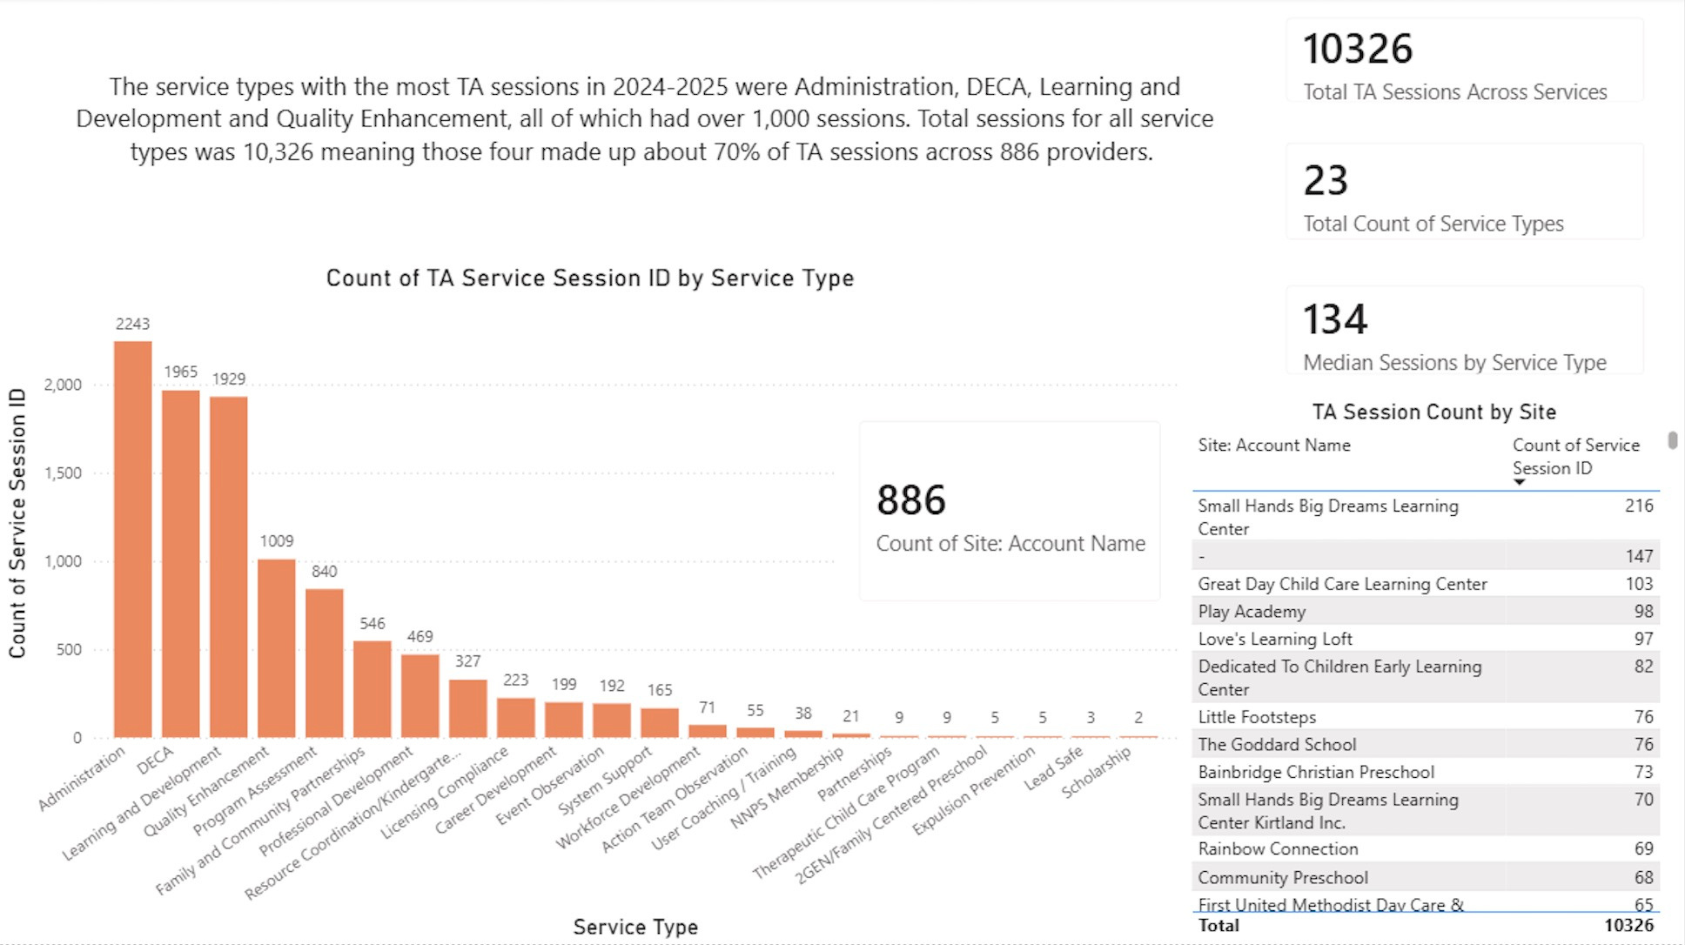

Slide 6
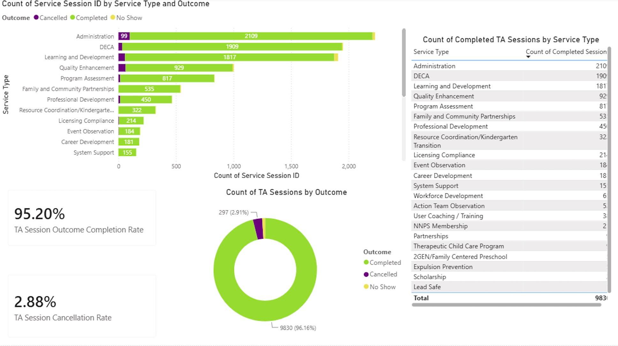

Slide 7
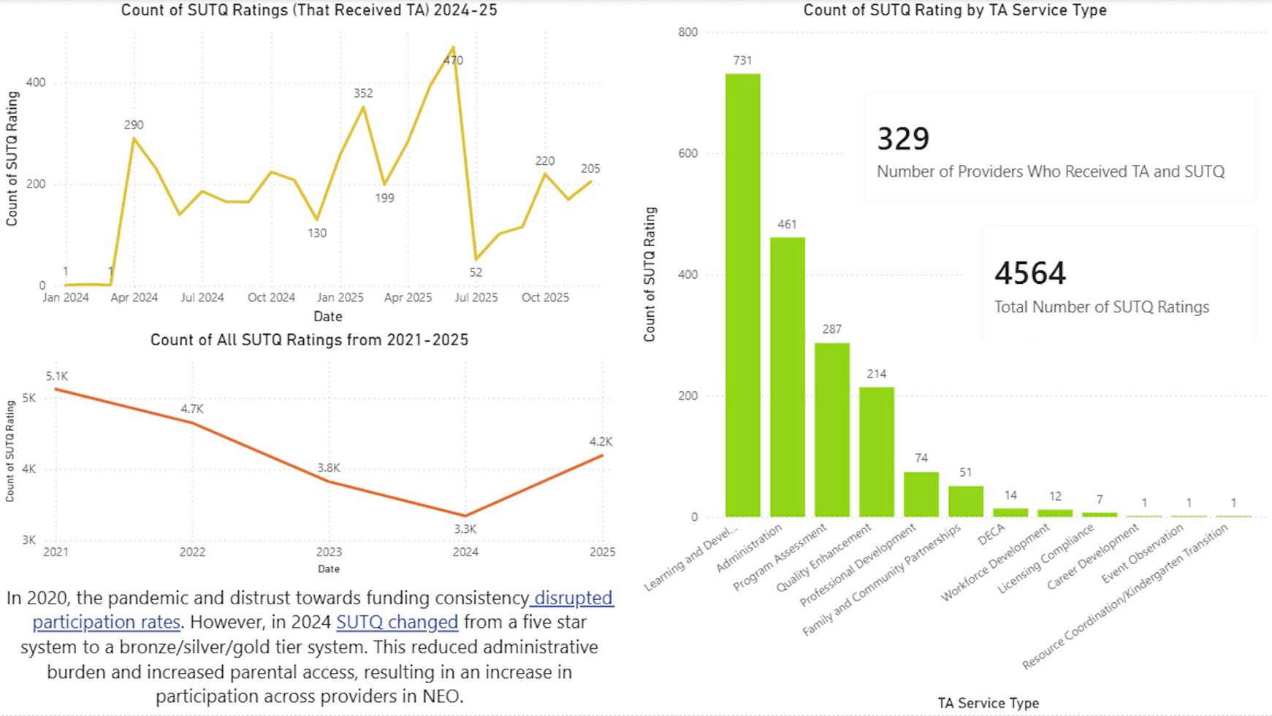

Slide 8
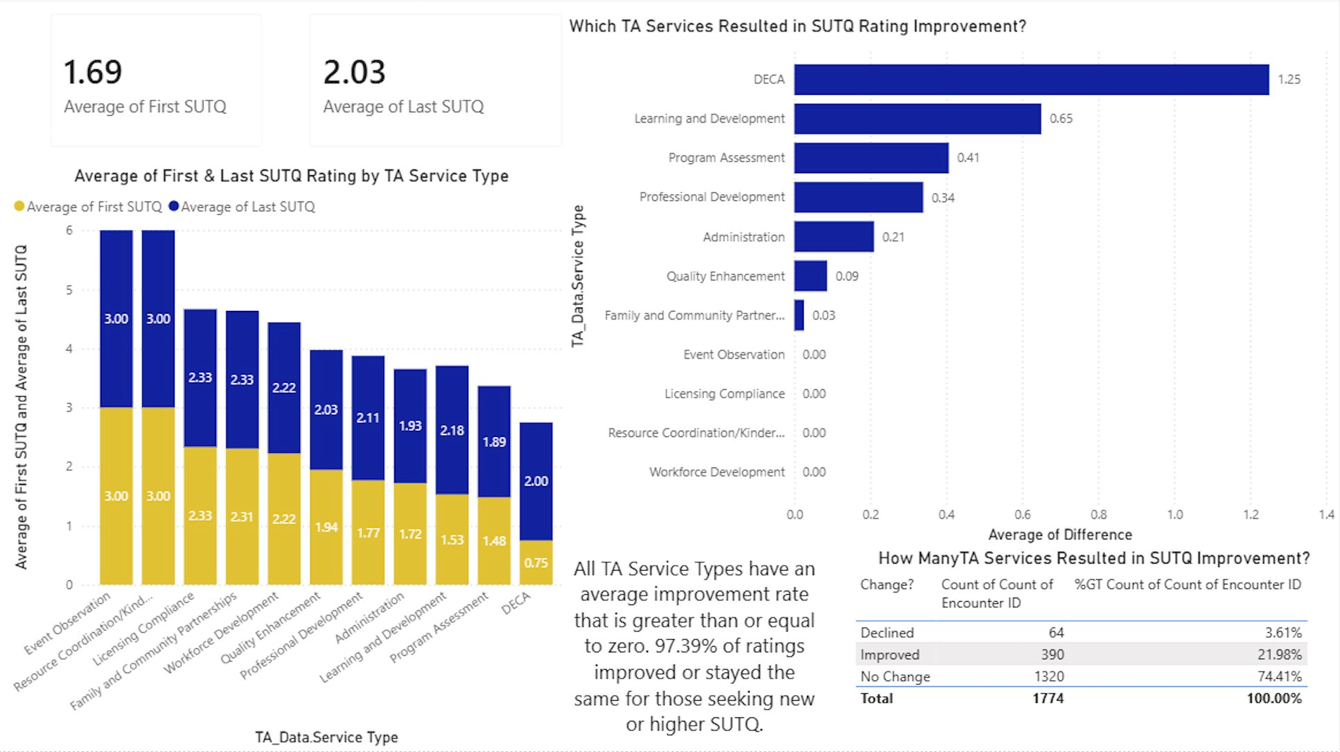

Slide 9
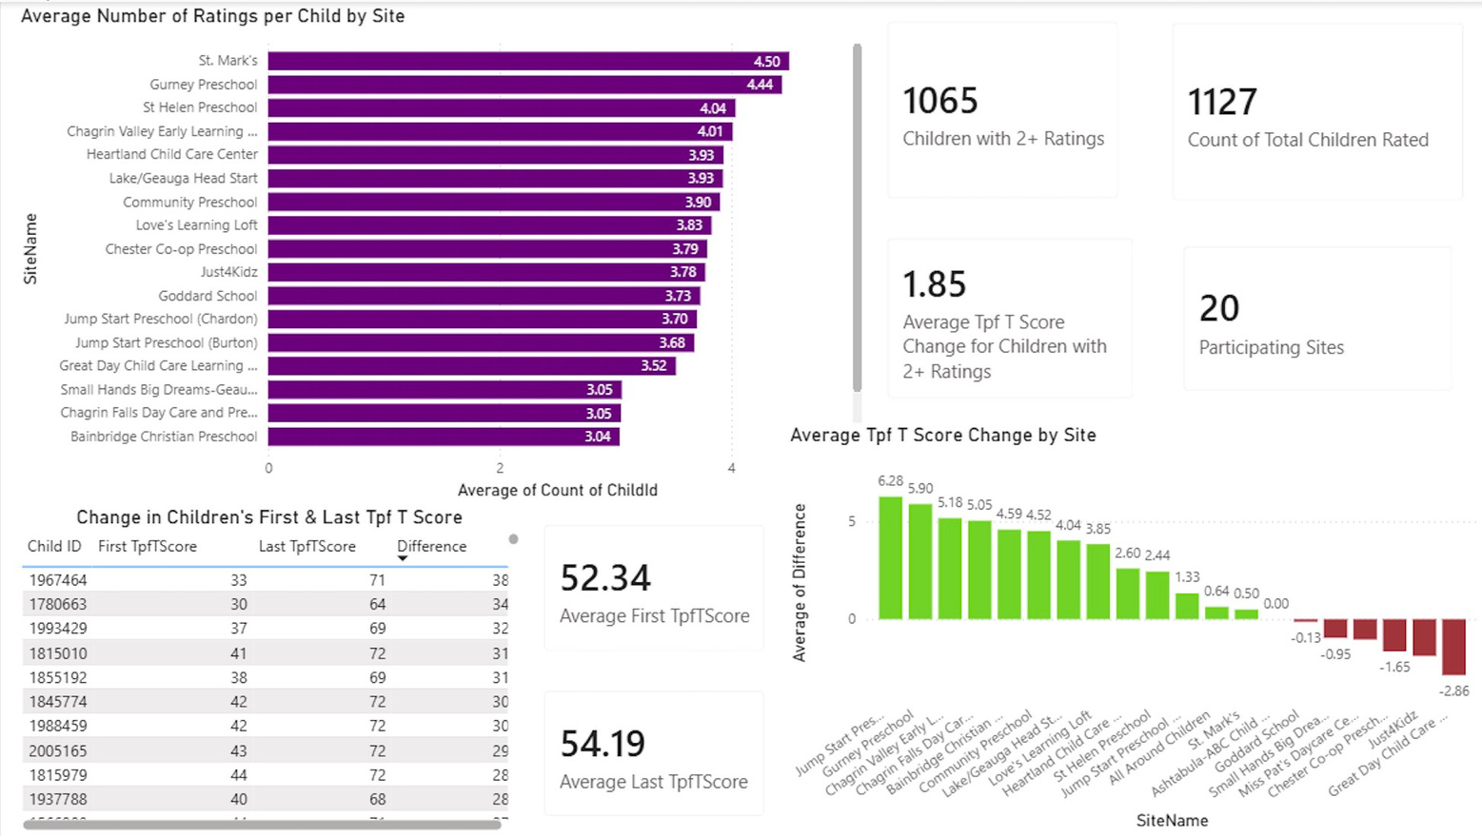
Part II: Devereux Early Childhood Assessment
My goal was to compare how children across different child care centers performed developmentally before and after undergoing evaluation by an early childhood development assessment called DECA. TPF stands for total protective factors and is the most comprehensive measure which is why I analyzed t-scores from this category. I then, using Excel, calculated each child’s (with 2+ sessions) score improvement and categorized them by Improved, Declined and No Change and compared which sites had the highest improvement rates to determine where children are performing the strongest.

Slide 10
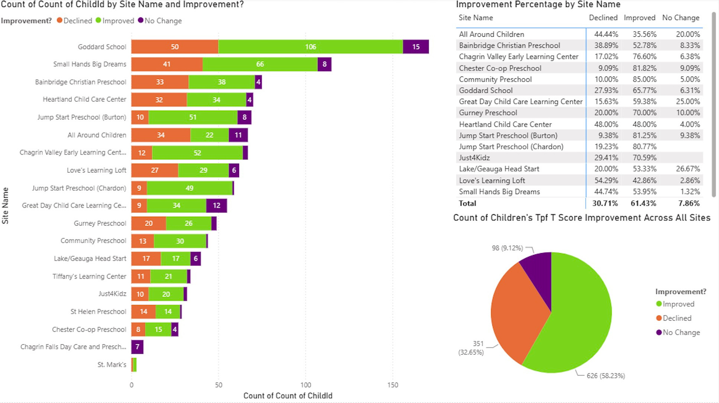

Slide 11
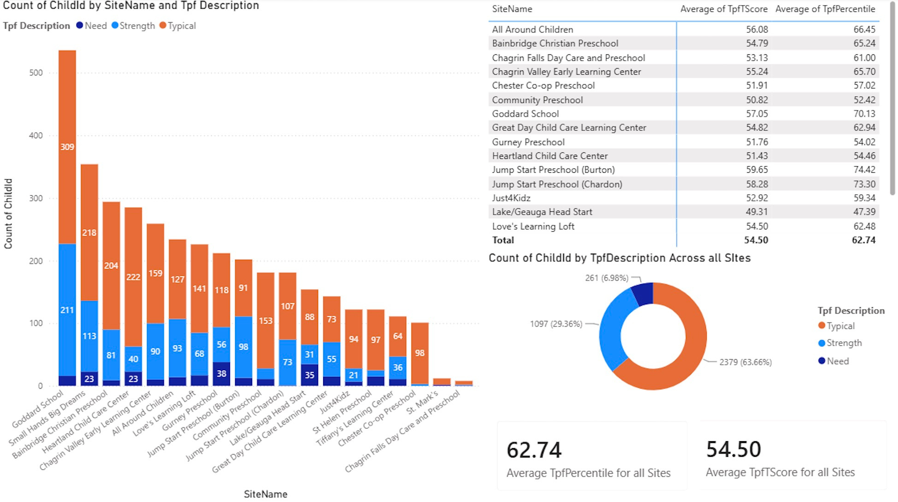

Slide 12
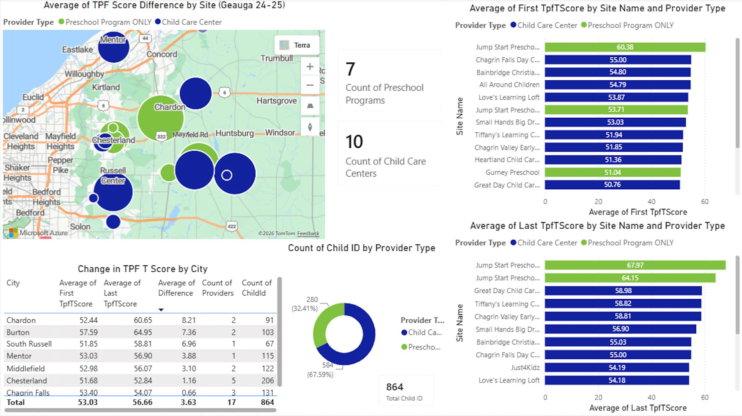

Slide 13
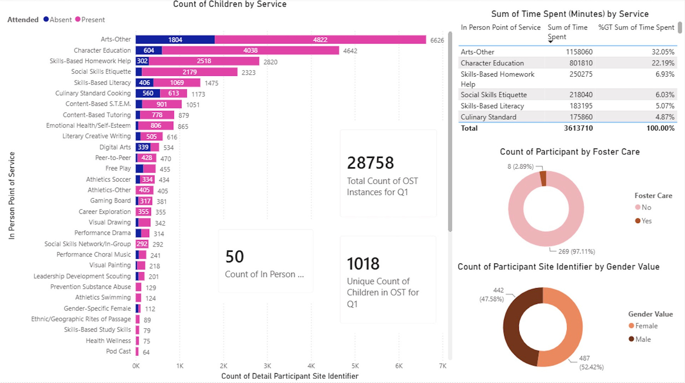
Part III: Out of School Time
My goal with this part of the project was to determine where dependency on Out of School Time programs is the highest. I analyzed quarterly data first and then considered yearly outcomes.

Slide 14
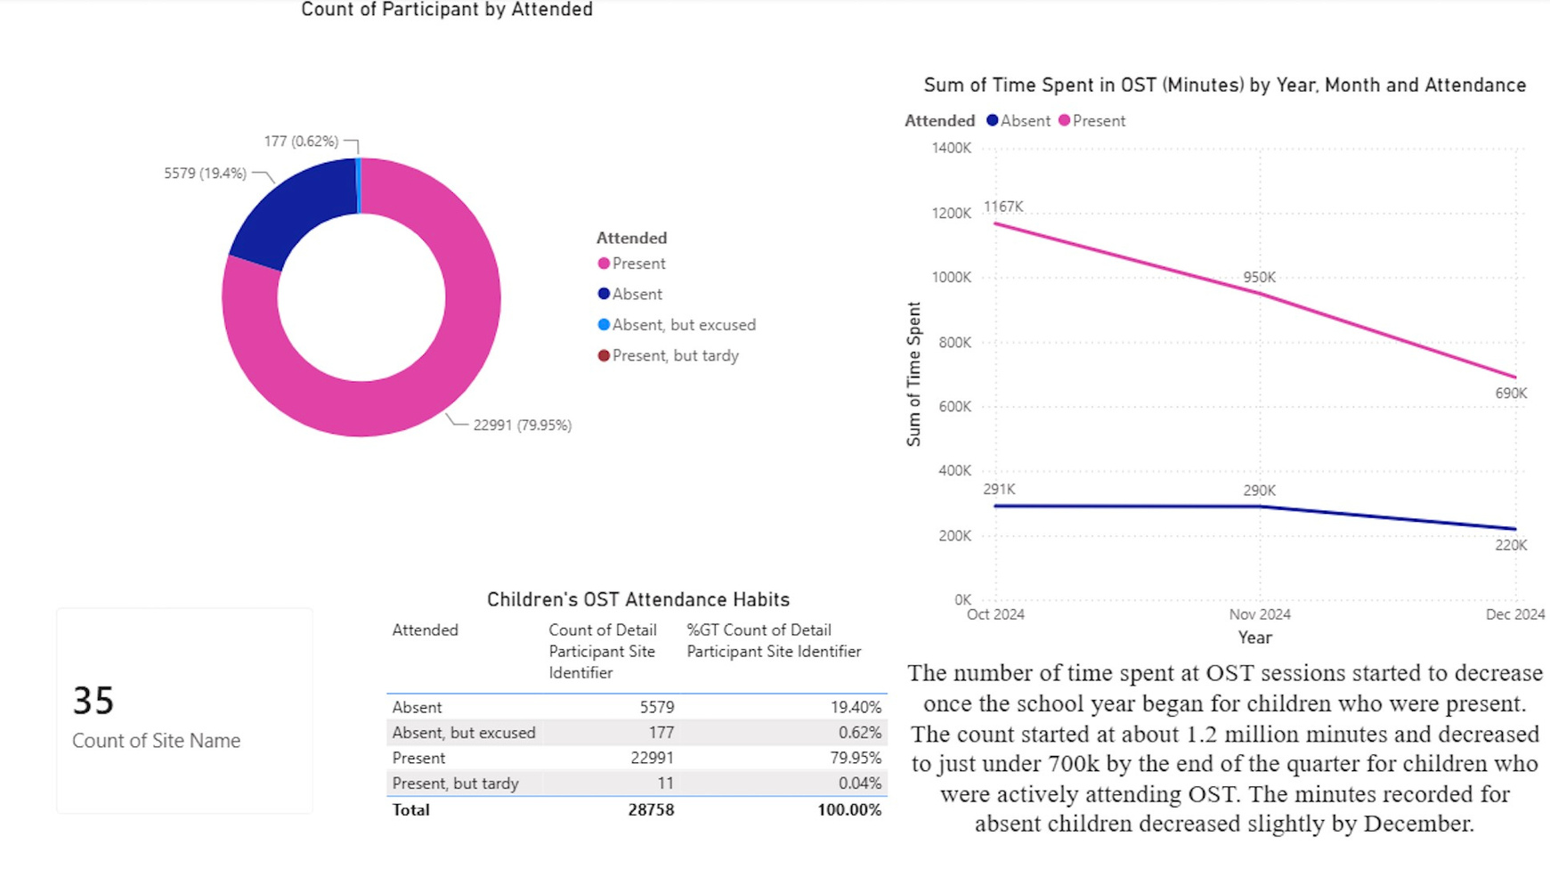

Slide 15
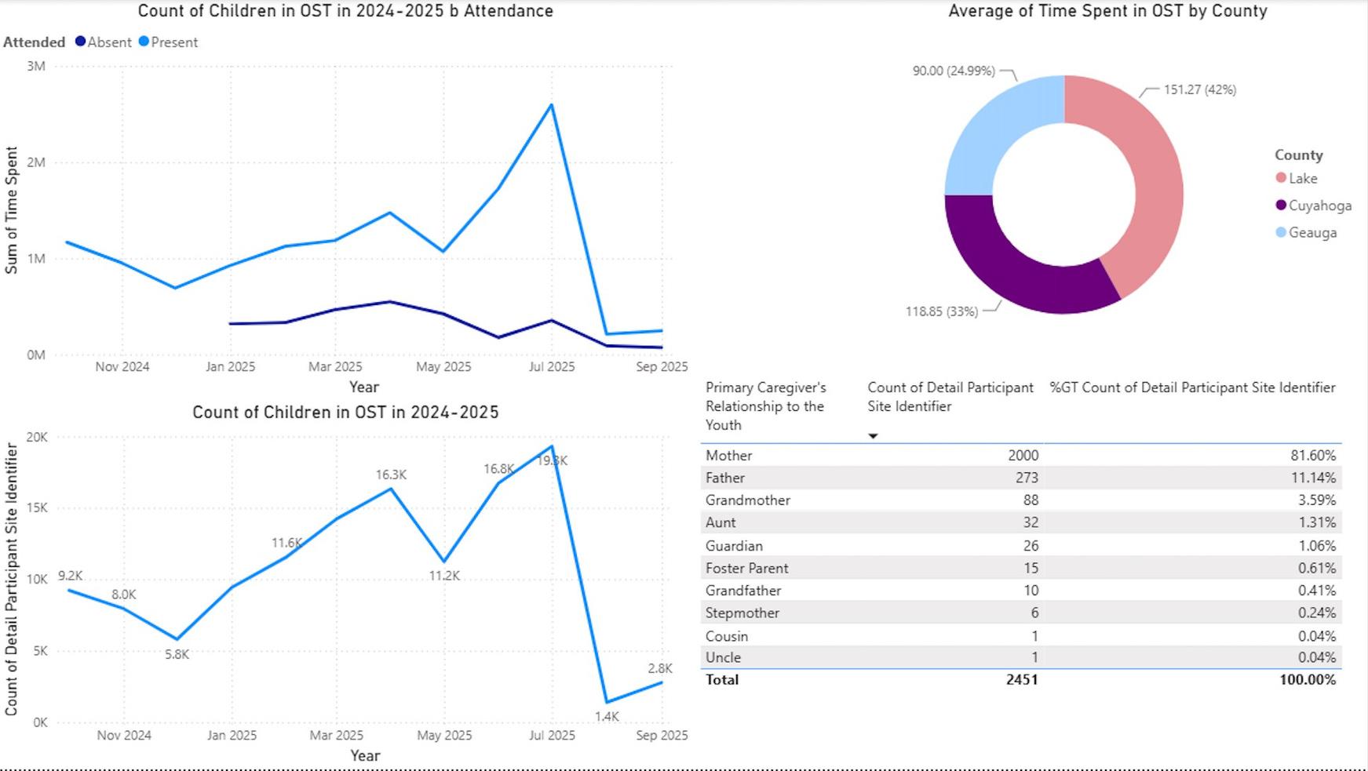

Slide 16
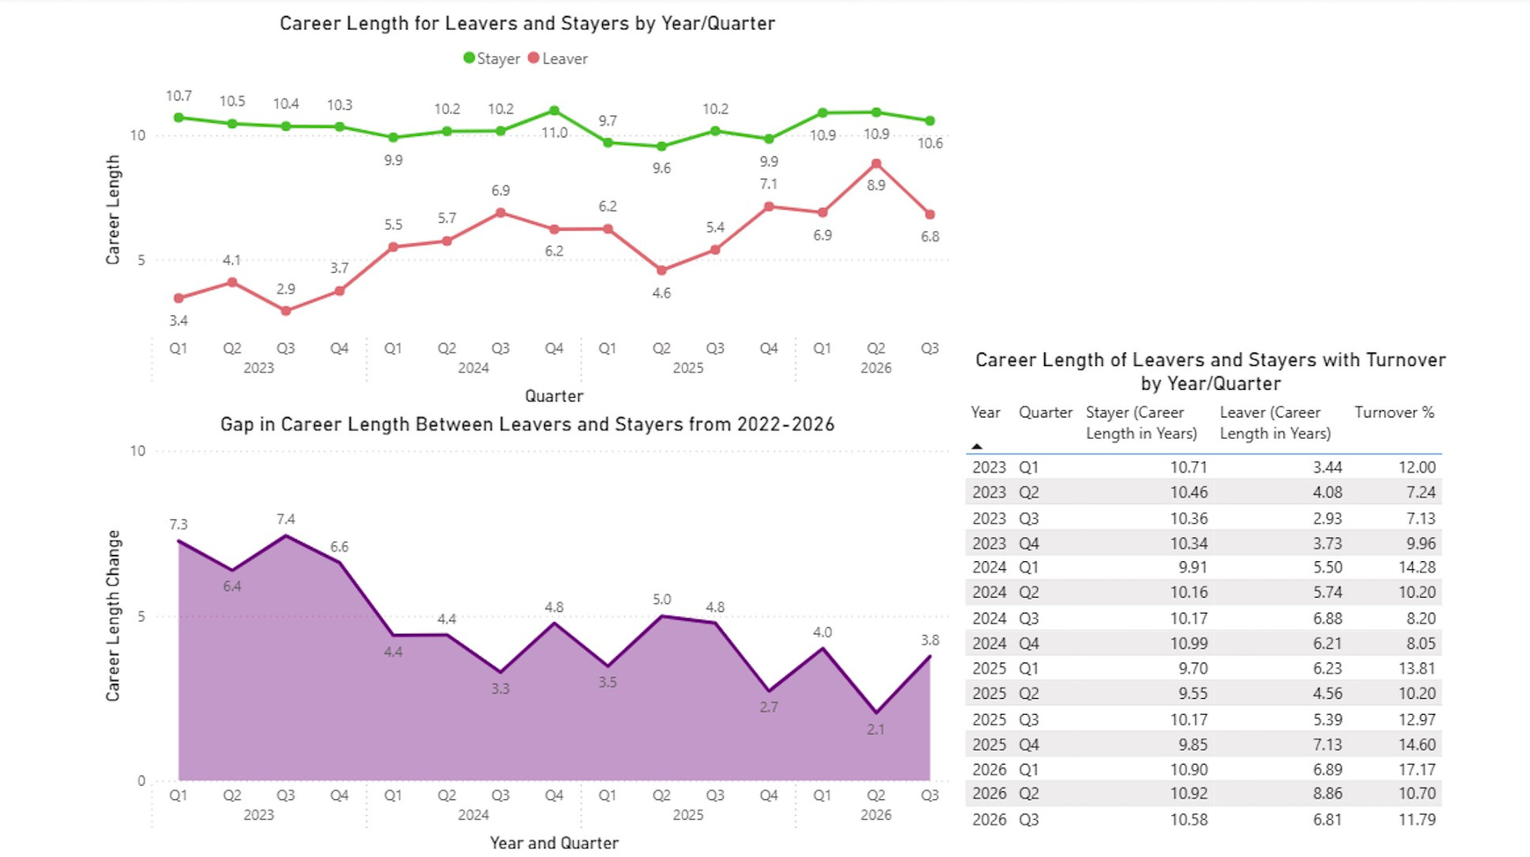
Part IV: Workforce Development
My goal with this part of the project was to better understand how the early childhood care workforce has changed over time.
08 September, 2026

Slide 17
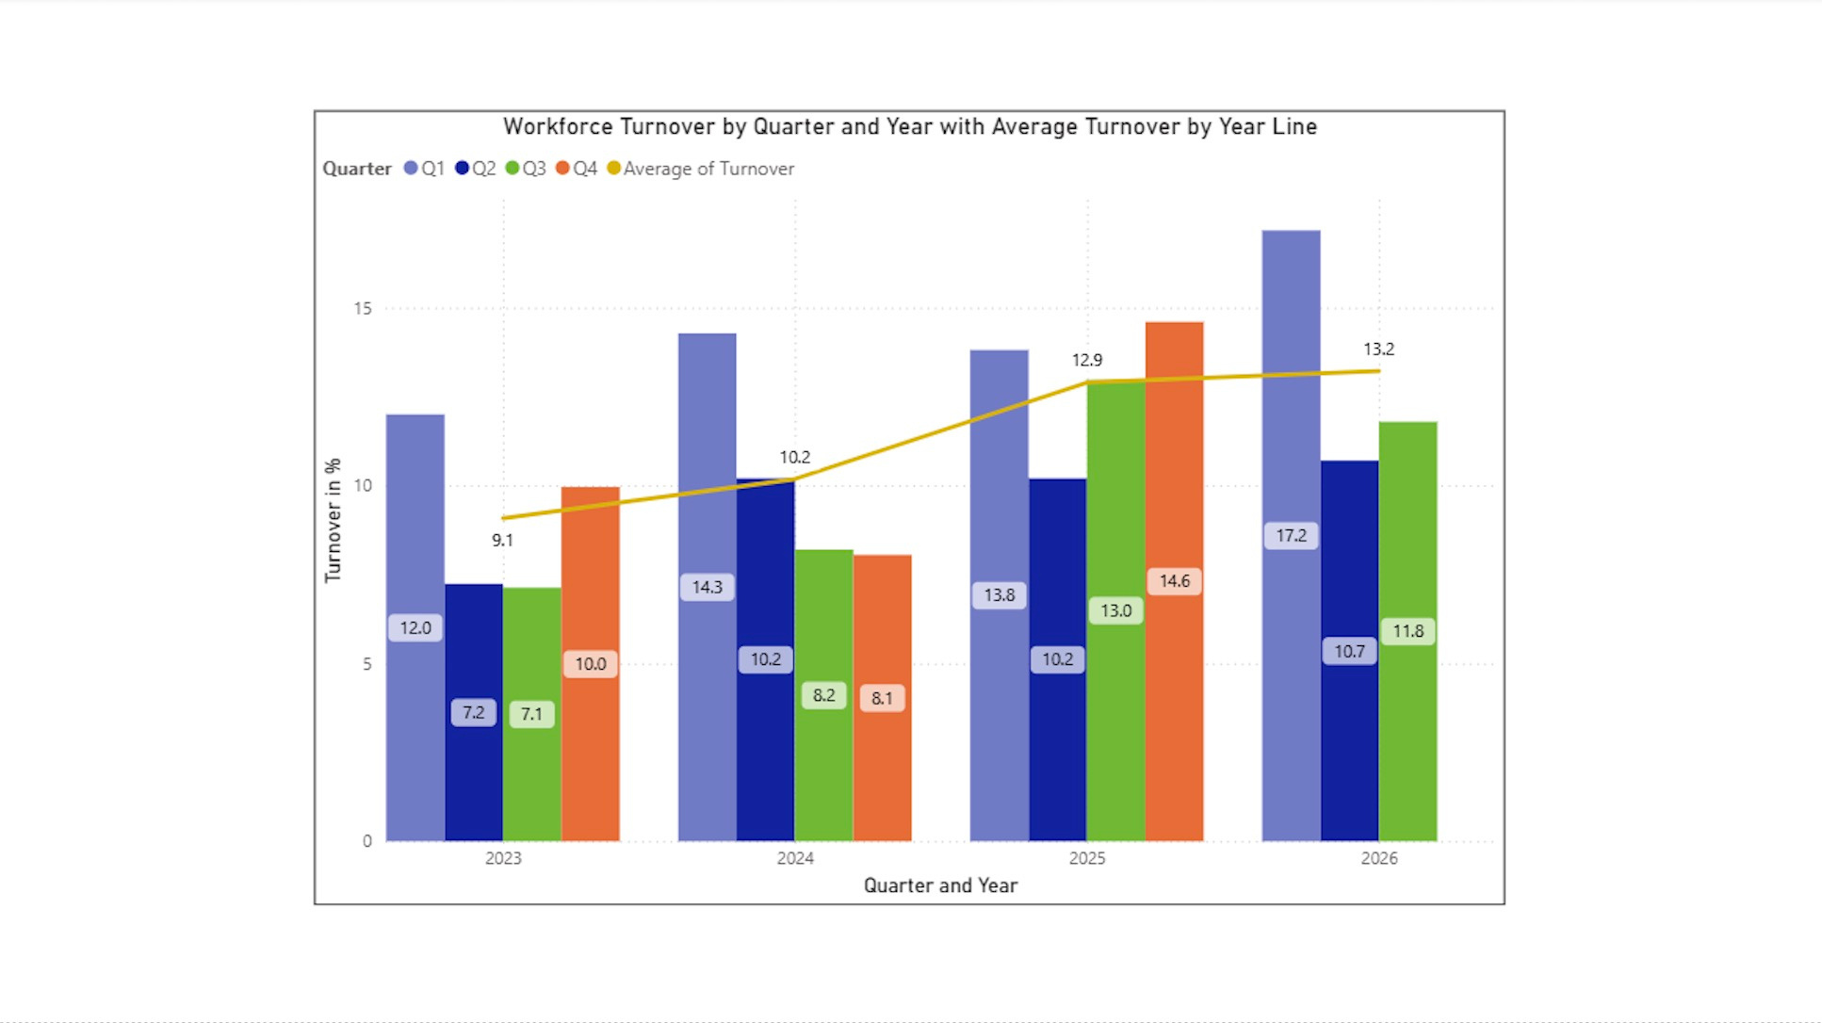

Slide 18
LET'S
WORK TOGETHER!
Name of Project:
Presented By:
Email: delic.hena@gmail.com
LinkedIn
Data Analysis Portfolio
Hena Delic

